Slide 1
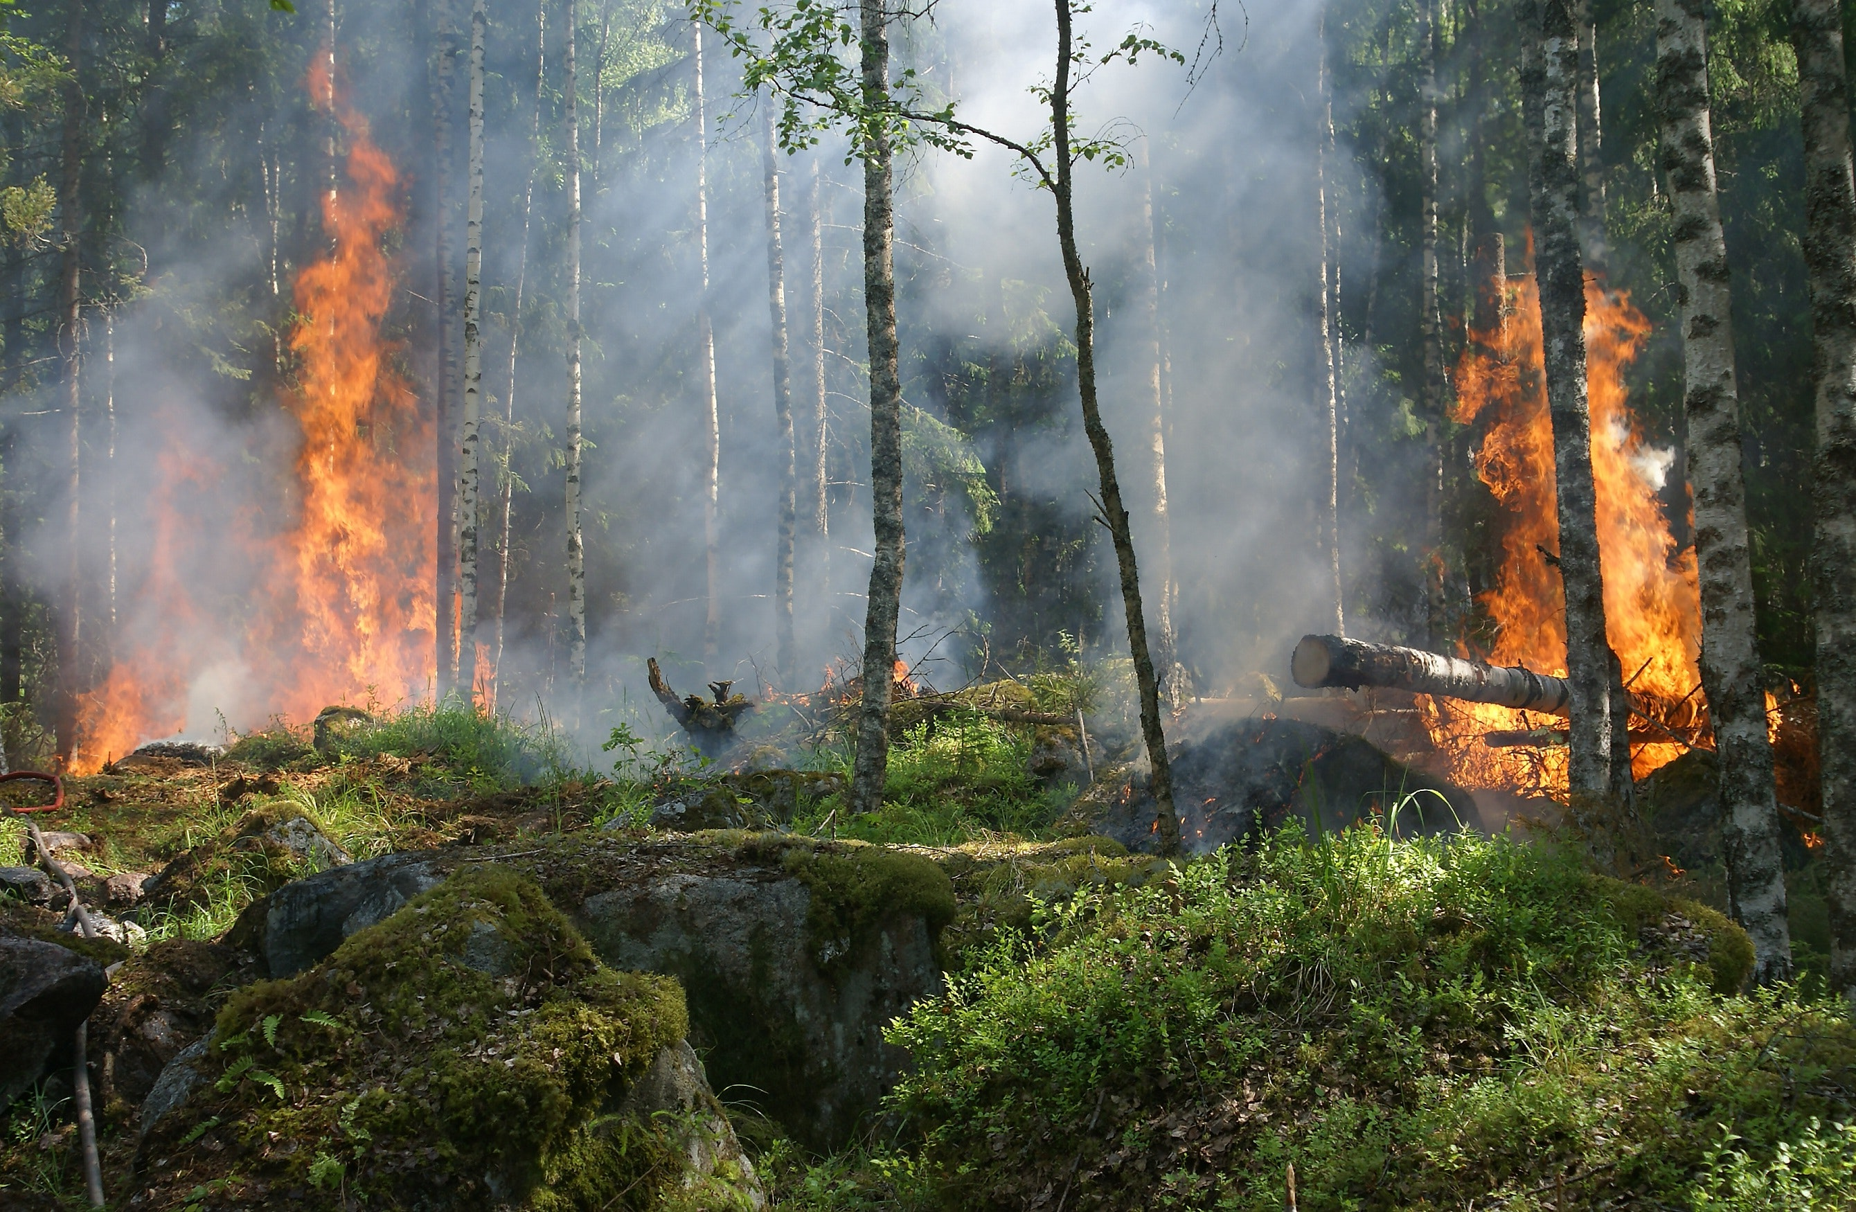
Saving Souls
Team name: I’m Groot
Team member: Shiva Sundaram
TISB Grade 7
Notes:
Photo by Pixabay: https://www.pexels.com/photo/forest-on-fire-51951/

Slide 2
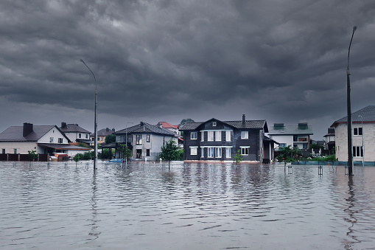
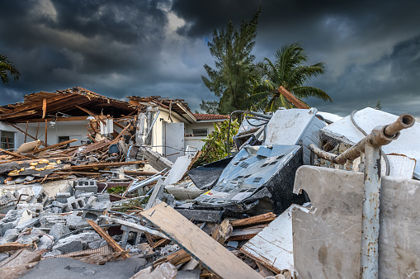
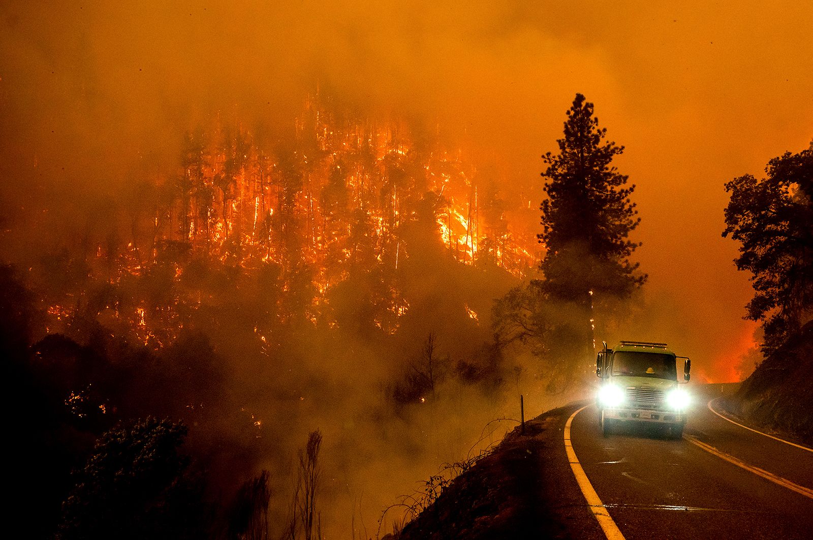
Natural Disasters
Global economic damage from Flood in 2022 alone was ~$19B and ~7400 lives were lost
Global economic damage from Earthquake in 2022 alone was ~$9.5B and ~1300 lives were lost
Global economic damage from Wildfire in 2022 accounted for ~$740M (10M acres burned in US). While relatively fewer lives (~75) were lost, it has increased by 250% from a decade ago
Source: National Interagency Fire Center (NIFC)
Source: EM-DAT, CRED / Université catholique de Louvain, Brussels (Belgium)
Notes:
Global economic damage from Wildfire, Flood and Earthquake accounted for ~$36billion
Wildfire acres burned in the United States alone has increased by 196% in the last decade

Slide 3
Every minute gained through prediction of a disaster, can save lives, natural resources, infrastructure and property

Slide 4

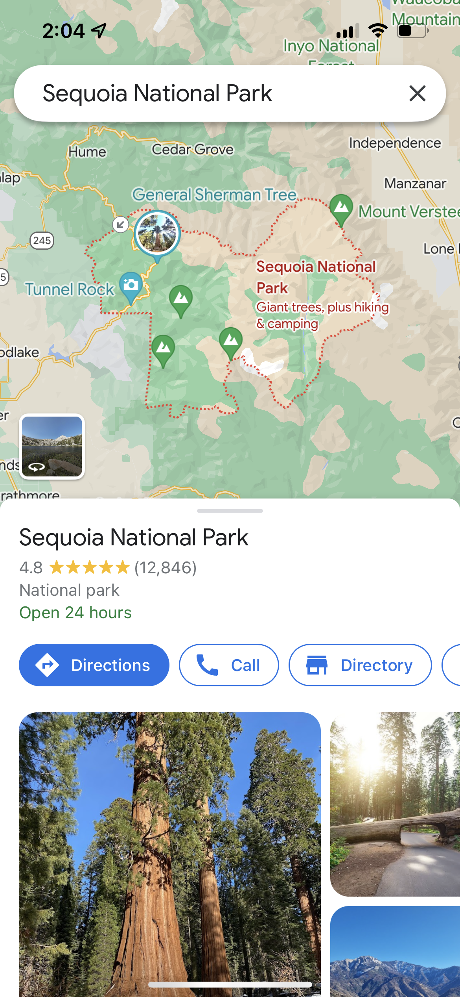
Solution
PROGRAM
DATA SET
TRAIN MODEL
Location
CHECK ACCURACY
Wildfire Alert
PREDICT
Notes:
Train AI on where and when wild fires have occurred in the past and predict an upcoming wildfire
Given a place & time, AI can predict if there is an upcoming wildfire using the ML model
Result of the prediction will be surfaced on Google Maps and Weather contextually. It will also be surfaced on websites where people search for places (ex: trip booking)

Slide 5
Train and Predict
Steps
Libraries Used
Source
Filtered the data set for Wildfire incidents in Alameda county from California dataset.
Trained the Deep learning model with the dataset (year 2016 – 2018)
Checked for accuracy against year 2019
Made prediction for 2023
Used pandas to read the dataset from comma separate file (csv)
Used numpy, tensorflow, keras for training, checking accuracy and prediction
Used Keras.SDG optimizer
Stochastic Gradient Descent (SGD)
Source of datasets
https://www.kaggle.com/datasets/ananthu017/california-wildfire-incidents-20132020
https://www.kaggle.com/datasets/sobhanmoosavi/us-weather-events
Source of code
https://www.kaggle.com/code/shidharthoroy/wildfires-in-california-prediction

Slide 6
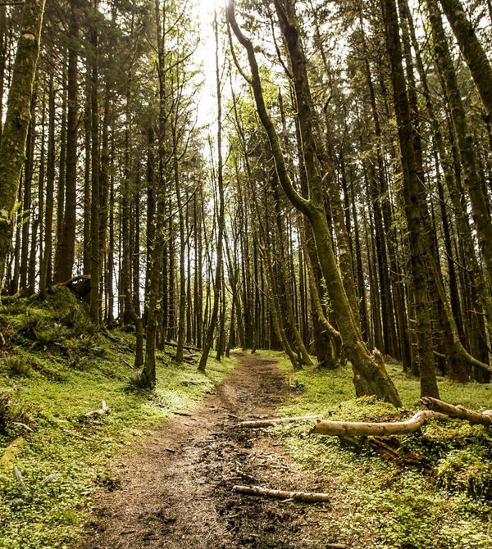
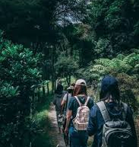
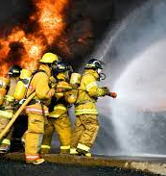
Next Steps
Save Nature & Wildlife
Work with Forest Department officials to adopt the app to get warnings about potential Wildfires
Keep People Safe
Assess options to embed the Wildfire Warning in apps/websites that people typically use such as Google Maps, Weather, Trip planning apps like BookMyTrip etc. so we can contextually warn people if they are in the vicinity or planning to visit
Prevent People & Material Loss
Work with Fire Department officials to adopt the app to get warnings about potential Wildfires

Slide 7




Thank you

